Slide 1
The math behind PCA
Using simple linear algebra in order to understand the math behind PCA.
Eigen-decomposition of the covariance matrix.
Notes:
This lecture is about mathematical details behind the principal component analysis.

Slide 2
PCA
The steps to compute a PCA:
Center the data
Calculate the covariance matrix
Calculate eigenvalues of the covariance matrix
Calculate eigenvectors of the covariance matrix
Order the eigenvectors
Calculate the principal components

Slide 3
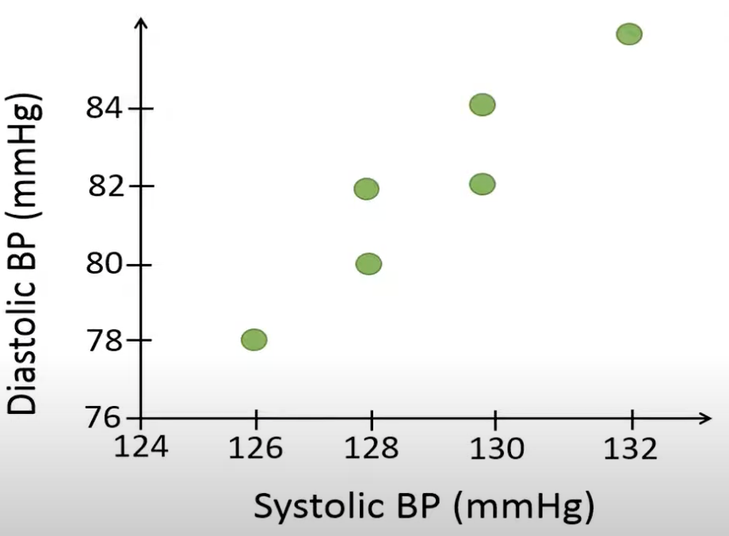
Example data
Systolic BP | Diastolic BP
126 | 78
128 | 80
128 | 82
130 | 82
130 | 84
132 | 86
Notes:
We will use PCA to combine the two blood pressure variables into just 1 variable based on data from 6 individuals. For example, person 1 has a diastolic blood pressure of 78 and a systolic blood pressure of 126 whereas person 2 has a diastolic blood pressure of 80 and a systolic blood pressure of 128 and so on. This data seems to be a strong positive correlation between 2 variables.

Slide 4
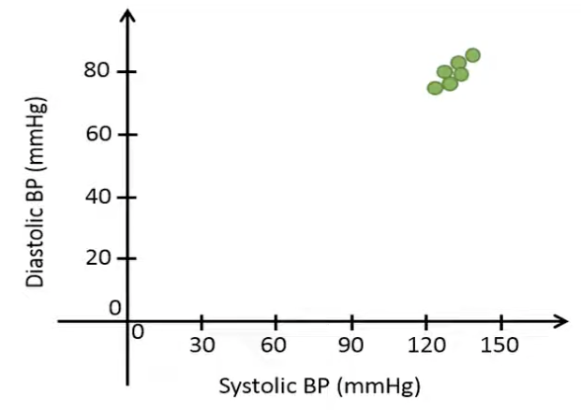
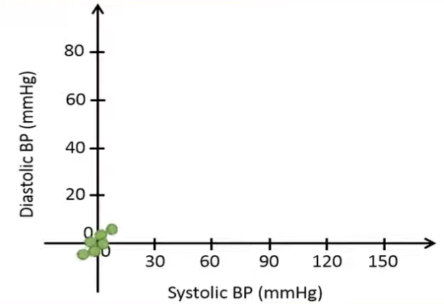
1. Center the data
Systolic BP | Diastolic BP
126 – 129 = -3 | 78 – 82 = -4
128 – 129 = -1 | 80 – 82 = -2
128 – 129 = -1 | 82 – 82 = 0
130 – 129 = 1 | 82 – 82 = 0
130 – 129 = 1 | 84 – 82 = 2
132 – 129 = 3 | 86 – 82 = 4
Centered SBP | Centered DBP
-3 | -4
-1 | -2
-1 | 0
1 | 0
1 | 2
3 | 4
The centered data
Notes:
In this case, we center the data, which means that we subtract all the values for each variable by its corresponding mean. Therefore, we subtract the mean systolic blood pressure from the individual observations. Centering the systolic blood pressure results in the following values, which tell how far away the original values are from the mean. We do the same calculations for the diastolic. When we center the data, the data points will be around the origin. This will help us later when we rotate the data. This plot after centering the data, where the x-axis represents the centered systolic blood pressure, y-axis represents the centered diastolic blood pressure.

Slide 5
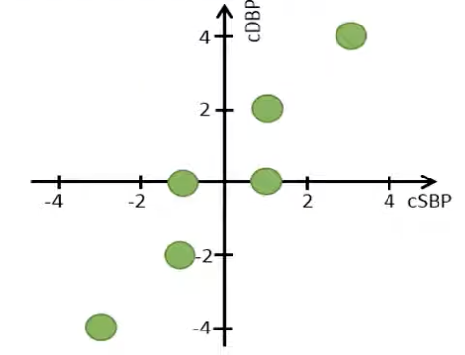
2. Calculate the covariance matrix
The variance of SBP
The variance of DBP
The covariance of SBP&DBP
Centered SBP | Centered DBP
-3 | -4
-1 | -2
-1 | 0
1 | 0
1 | 2
3 | 4
 | SBP | DBP
SBP | 4.4 | 5.6
DBP | 5.6 | 8
Notes:
Note that, we will get the same values in the covariance matrix if we instead would use the original data since the variance doesn’t change when we center the data. Remember that the main diagonal of the covariance matrix includes the variance of each variable. The sample variance of the centered systolic blood pressure is calculated like this. When we calculate the variance of the centered data, the calculations become a bit simpler since the mean of the centered data is always equal to 0. To calculate the sample variance of the centered data, we simply sum the squared values and divide by the sample size minus 1.
From the plot we see that the spread in the diastolic blood pressure is a bit higher compared to the spread in the systolic blood pressure.

Slide 6
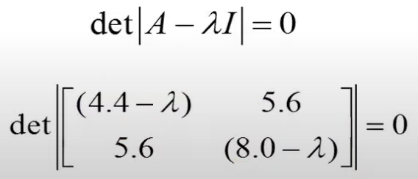
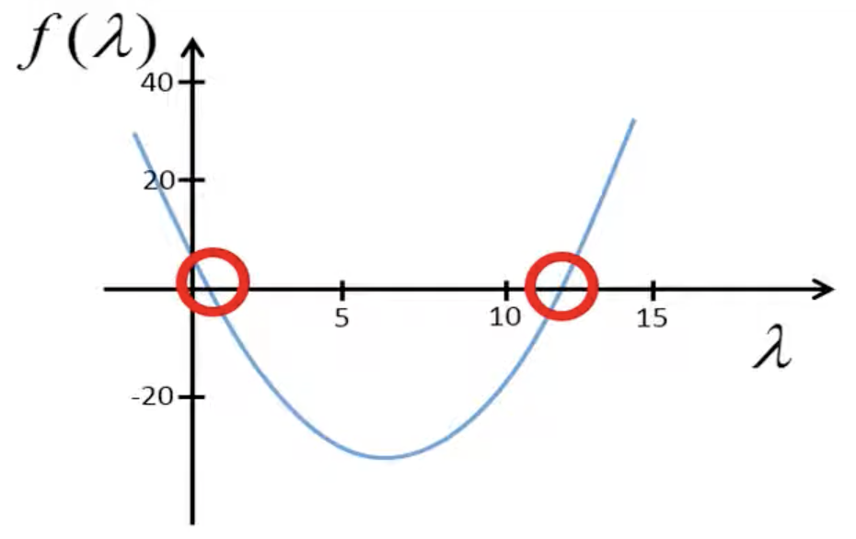



3. Calculate the eigenvalues of the covariance matrix
 | SBP | DBP
SBP | 4.4 | 5.6
DBP | 5.6 | 8
Eigenvalues of the covariance matrix
Notes:
We substitute A by the covariance matrix and this term by lambda times the identity matrix, which has the same number of rows and columns as the covariance matrix. Subtracting these 2 matrices result in the following matrix. Next, we calculate the determinant of this matrix. After some simplifications, we have the following quadratic equation.

Slide 7
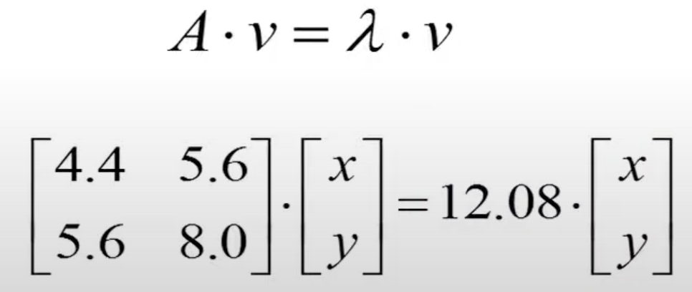
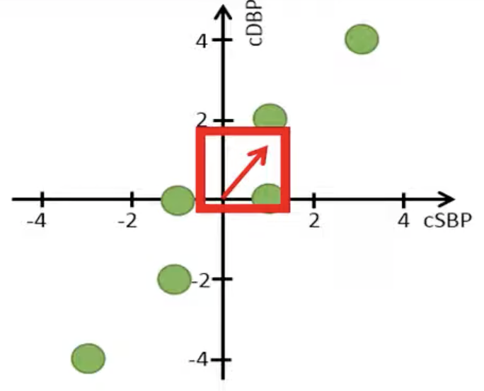
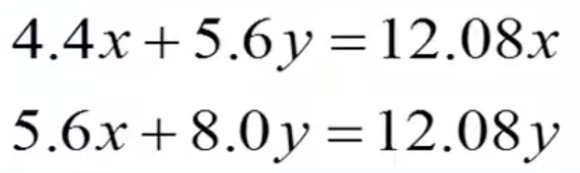
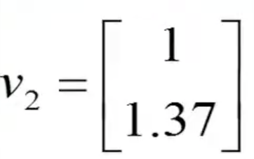
4. Calculate the eigenvectors of the covariance matrix
 | SBP | DBP
SBP | 4.4 | 5.6
DBP | 5.6 | 8
An eigenvector of the covariance matrix
Notes:
We will start by calculating the eigenvector of the covariance matrix with the corresponding eigenvalue 12.08. we use this equation. We plug in the covariance matrix and one of the 2 eigenvalues. We can illustrate this vector in the plot.

Slide 8
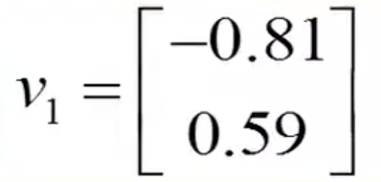
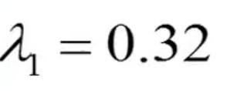
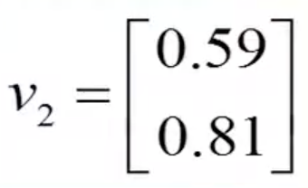
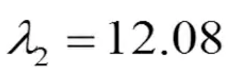
4. Calculate the eigenvectors of the covariance matrix
Normalization eigenvector
Notes:
Now we normalize this vector to unit length, which means that it should have a length of 1. We do the same with the second eigenvector (0.32).

Slide 9
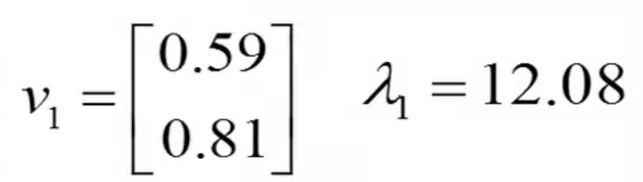
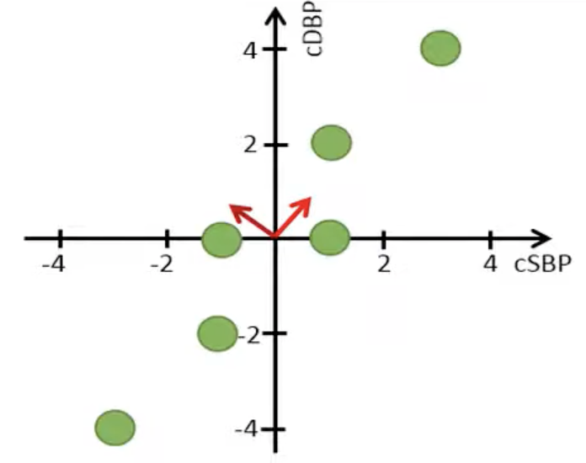
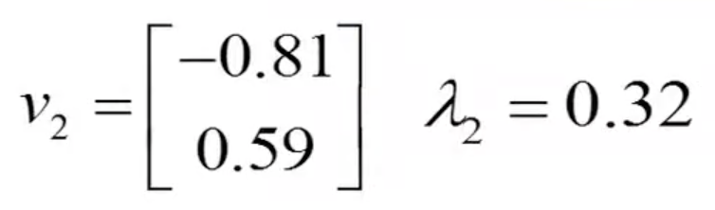
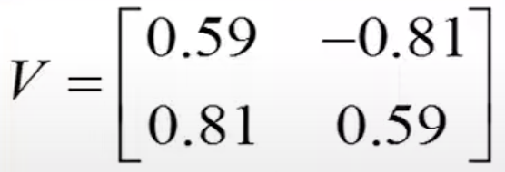
5. Order the eigenvectors
Order the eigenvectors based on their corresponding eigenvalues
Put these two eigenvectors together into a matrix
Notes:
Since the covariance matrix is a symmetric matrix, the eigenvectors will be orthogonal, which means that the angle between them is 90 degrees. Next we order the eigenvectors based on their corresponding eigenvalues, where the eigenvector with the largest eigenvalue becomes our first eigenvector. Since this eigenvector has the largest eigenvalue, it will represent our first eigenvector. We name this vector v1 instead of v2. Let’s put these two eigenvectors together into a matrix, where the first column represents the first eigenvector with the highest eigenvalue, and the second column represents the second eigenvector.

Slide 10
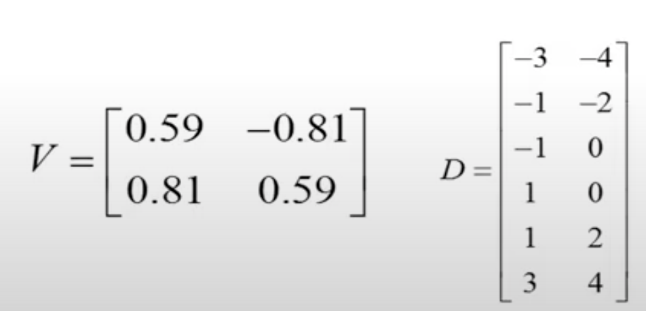
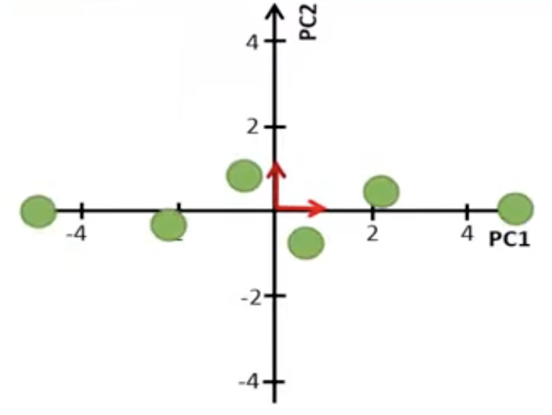
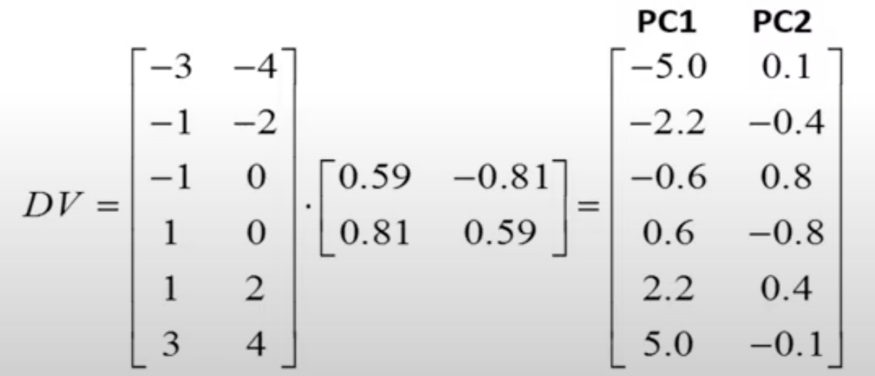
6. Calculate the principal components
The score plot
Notes:
We use this matrix to transform our original centered data so that the 2 variables are completely uncorrelated. We define a matrix D, which includes our centered data. Next, we multiply our data matrix D by matrix V, which includes our eigenvectors as columns. Then we get a new matrix with transformed data.
When we go from our original data matrix to transformed data, it can be seen like we rotate the data clockwise until the 2 eigenvectors point in the same direction as the x and y-axes of the plot.
Note that the label of the axes have been changed to principal component 1 and 2. We have the score plot after doing rotation.

Slide 11
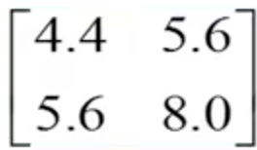
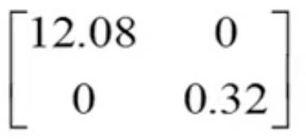
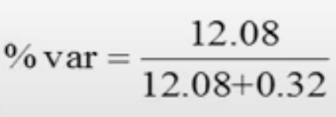
Interpret PCA
The centered data
The transformed data
Centered SBP | Centered DBP
-3 | -4
-1 | -2
-1 | 0
1 | 0
1 | 2
3 | 4
var = 4.4 | var = 8.0
PC1 | PC2
-5 | 0.1
-2.2 | -0.4
-0.6 | 0.8
0.6 | -0.8
2.2 | 0.4
5 | -0.1
var = 12.08 | var = 0.32
The first principal component captures 97.4% of the total variance
Notes:
Let’s compare the centered data with the transformed data. The variance of the systolic blood pressure is 4.4 whereas the variance of the diastolic blood pressure is 8. We see that the covariance is 5.6, which tells us that there is a positive correlation between the two variables. When we transform the data, using PCA, the first variable called PC1 has a variance of 12.08 whereas PC2 has only a variance of 0.32. This means that almost all variance is kept in the first principal component. If we divide the variance of the first principal component by the total variance, we see the first principal component captures 97.4% of the total variance.
Note that the variance of the principal components correspond to the two eigenvalues we calculated earlier. Thus, the eigenvalues of the covariance matrix represent the variances of the principal components. When we study the covariance matrix of our transformed data, we see that the covariance between PC1 and PC2 are equal to 0, which means that PC1 and PC2 are completely uncorrelated. We also see the variance of PC1 and PC2, correspond to the eigenvalues associated to the first and the second eigenvector. Note that the total variance of PC1 and PC2 is 12.4, which corresponds to the total variance of the original variables.

Slide 12
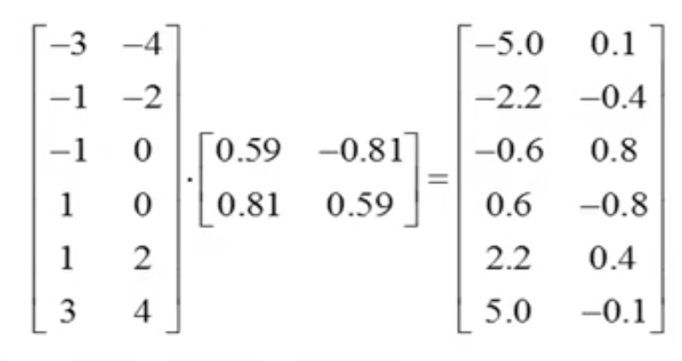
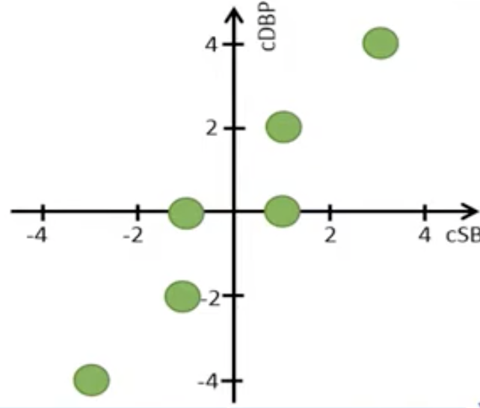
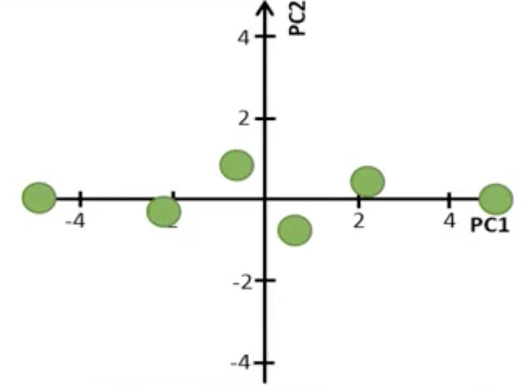
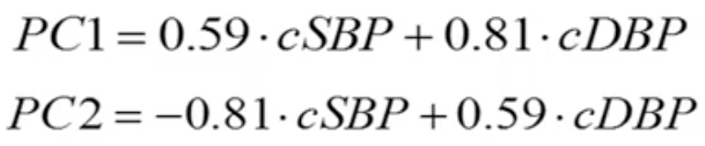
Interpret PCA
The centered data
The transformed data
Centered SBP | Centered DBP
-3 | -4
-1 | -2
-1 | 0
1 | 0
1 | 2
3 | 4
var = 4.4 | var = 8.0
PC1 | PC2
-5 | 0.1
-2.2 | -0.4
-0.6 | 0.8
0.6 | -0.8
2.2 | 0.4
5 | -0.1
var = 12.08 | var = 0.32
Notes:
Remember that when we multiplied the centered data by the matrix that includes the eigenvector as columns, we got the transformed data. This is the same as using this equation to calculate the principal components that we saw in the previous lecture. Where the weights for the first principal component comes from the first eigenvector with the highest eigenvalue whereas the weights for the second principal component comes from the second eigenvector.

Slide 13

Interpret PCA
The centered data
The transformed data
Centered SBP | Centered DBP
-3 | -4
-1 | -2
-1 | 0
1 | 0
1 | 2
3 | 4
var = 4.4 | var = 8.0
PC1
-5
-2.2
-0.6
0.6
2.2
5
var = 12.08
Delete PC2
Notes:
Since the first principal component captures almost all variance, which can be interpreted as it stores almost all information about the 2 variables, we can simply delete the second principal component because it includes almost no information. As we have seen previously, by using the following equation, we can combine 2 variables into just 1 variable, in a way that maximize the variance of the linear combination. The weights can be interpreted as how much each variable contributes to the principal component. Since the absolute of the weight for the diastolic blood pressure is higher than that of the systolic blood pressure, PCA put more weight on the diastolic blood pressure when the two variables are combined.

Slide 14

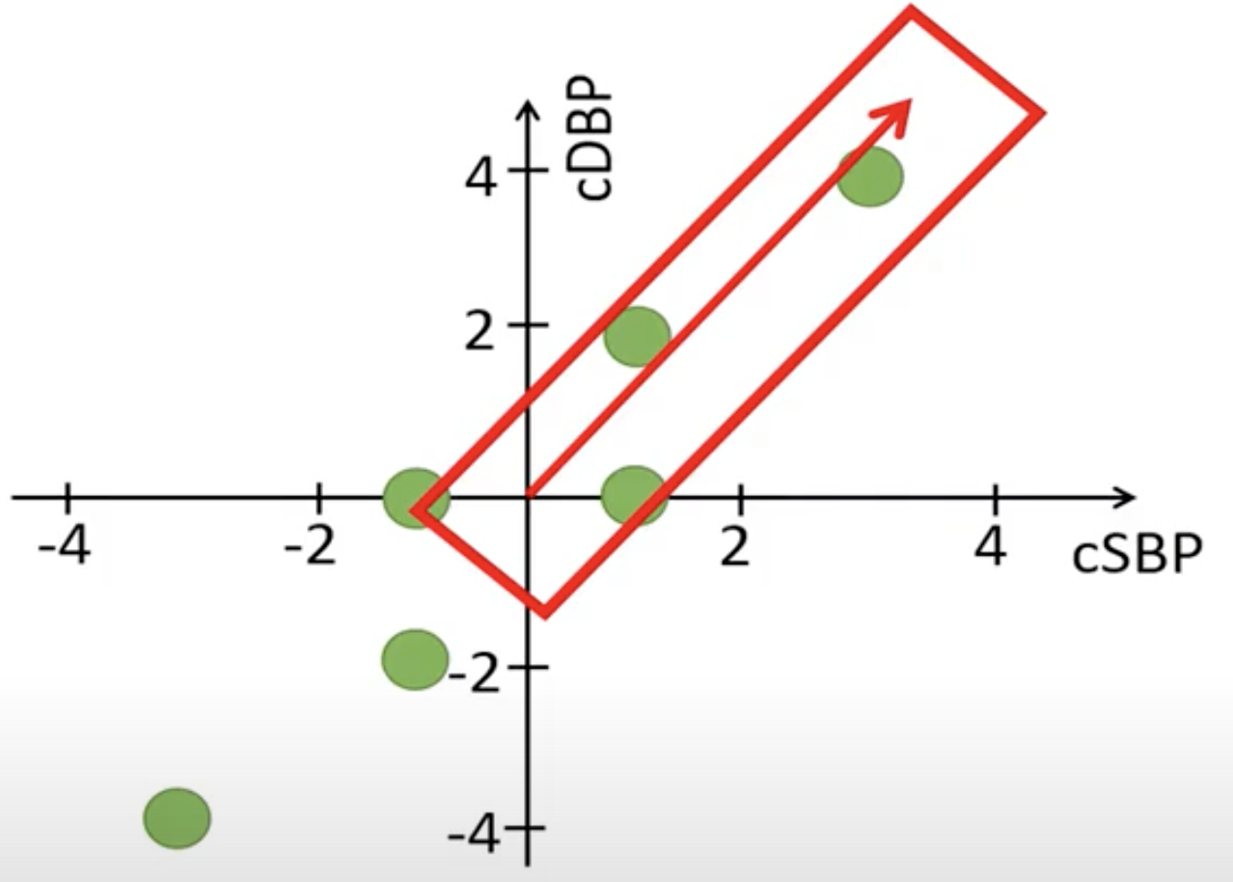
Interpret the eigenvector
Notes:
We see why the first eigenvector points in the same direction as the data. This is the previous eigenvector and if we extend it by multiplying by 6 we can draw this vector.
Note that this is also an eigenvector of the covariance matrix since it has the same direction as the eigenvector with the unit length.

Slide 15
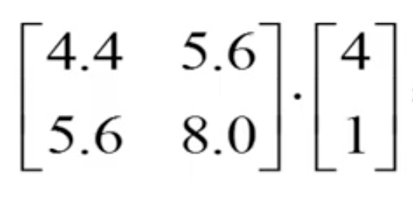
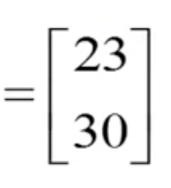
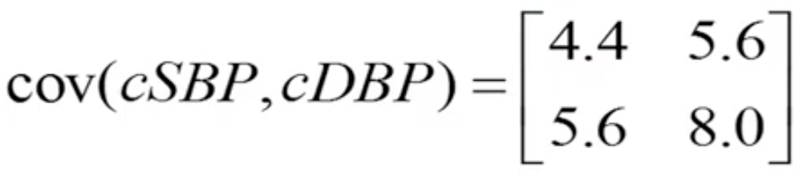
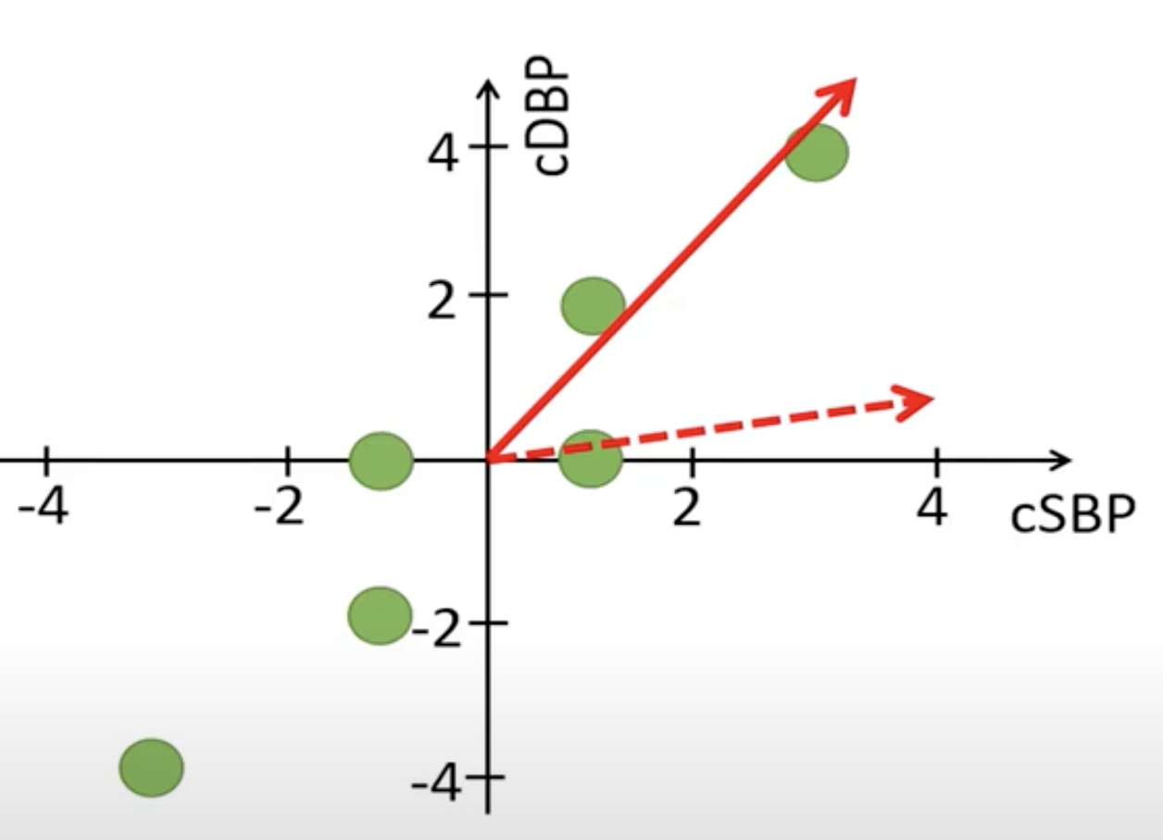
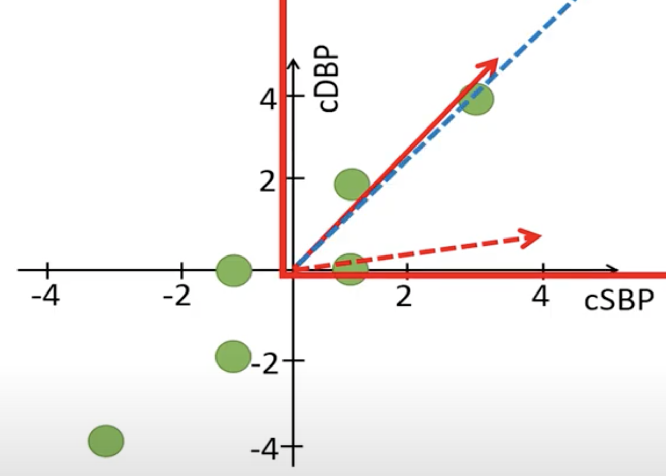
Interpret the eigenvector
Covariance matrix
Conclusion: The values in the covariance matrix rotate vectors towards the eigenvector, which points in a direction where the data has a maximal variance
Notes:
For example, let’s take an arbitrary vector with the coordinates 4 and 1, multiplying the covariance matrix by this arbitrary vector will result in the following vector. We see that the covariance matrix will rotate this vector so that it has a similar direction as the eigenvector.

Slide 16
References
Tilevik, A. (n.d.) PCA1: Math. Available online: https://www.youtube.com/watch?v=S51bTyIwxFs&t=1s

